Slide 1

Contoso Bank
Ciarah Desiree Suligan
ciarahsuligan@outlook.co.nz
Notes:
Please enter project details and your details here.

Slide 2



Personal Info ☺
Bachelor of Technology (Hons) – IT at UoA
Watching movies and American TV shows (Suits)
Best part of MSA – BOTS
Set up instructions uploaded before training.
This section is NOT assessed. We just want to get to know you ☺.
Notes:
This section is NOT assessed. We just want to get to know you ☺.

Slide 3

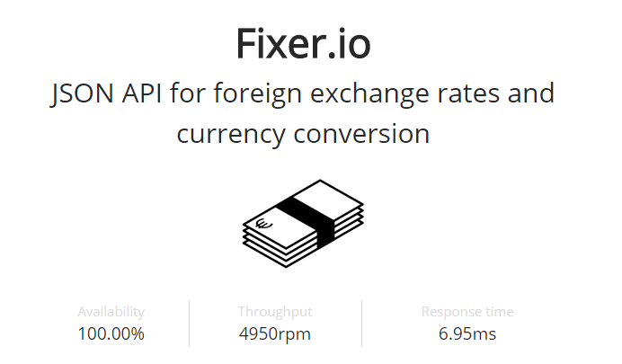
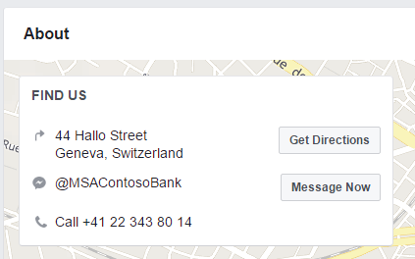
Currency Rates API – Fixer.io
No key required
JSON format
Rates published by the European Central Bank (Contoso Bank is located in Geneva, Switzerland)
Notes:
Advanced features…

Slide 4
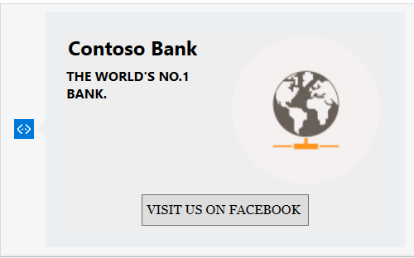
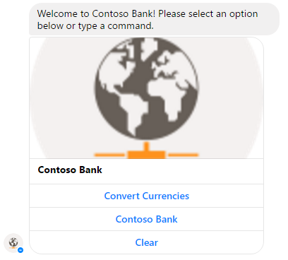
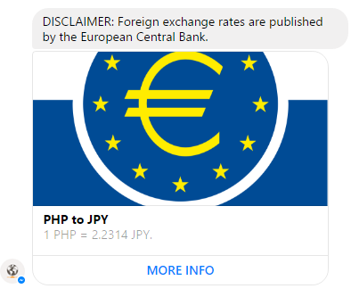
User Experience/Advanced Features
Custom bank branding
Sense of identity (Recognisable)
Matches slogan - “The world’s no.1 bank.”
Buttons for common commands and direct links.
Interaction other than just text
Ease of use
Efficiency
Cards - visual presentation
Notes:
User Experience

Slide 5
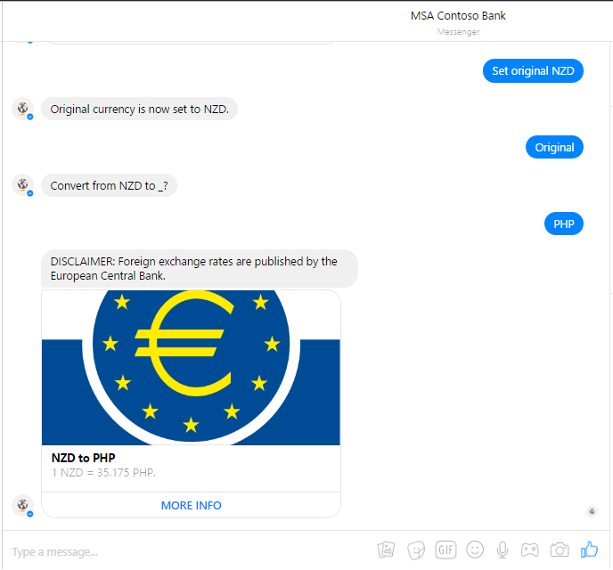
User Experience/Advanced Features
State service
Personalised experience
Setting default original currency
Published to a social media connection
Accessibility
Ease of use
Efficiency
Case in-sensitive
User-friendly
Notes:
User Experience

Slide 6
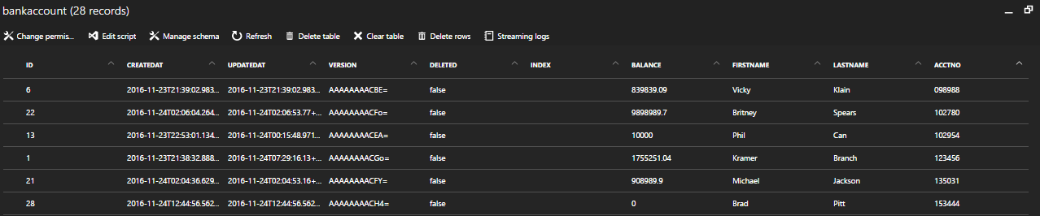
Databases
Table Name: BankAccount
Primary Key: ID (Unique)
Assuming that once an account has been deleted, the same AcctNo could be assigned to another person.
Fields: ID, FirstName, LastName, AcctNo, Balance
Contoso Bank – bank accounts, deposits, withdrawals
Notes:
Talk about your database, what schema you used and what data you used

Slide 7
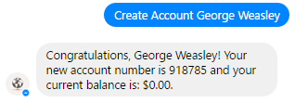
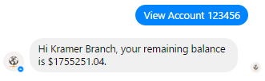
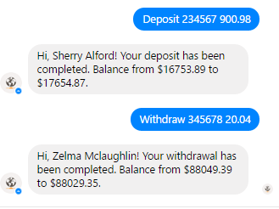
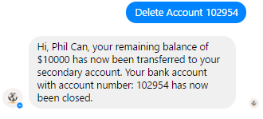
Databases - CRUD
Create – “Create Account”
Read – “View Account”
Update – “Deposit” / “Withdraw”
Delete – “Delete Account”
Notes:
Talk about your database, what schema you used and what data you used

Slide 8
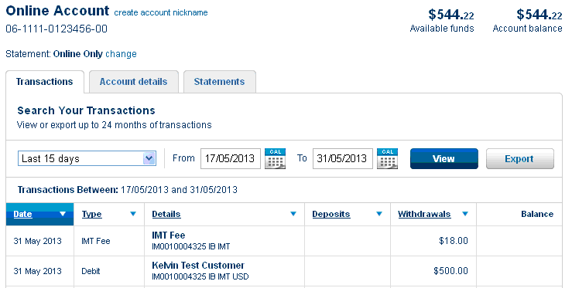

Final Comments Improvements to Consider
Databases
Store hashes instead of passwords for authentication
More user information
Additional APIs and Presentation
Stocks – carousel
LUIS natural language integration

